Slide 1

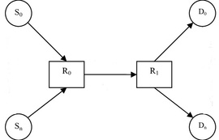

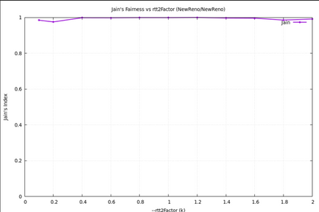
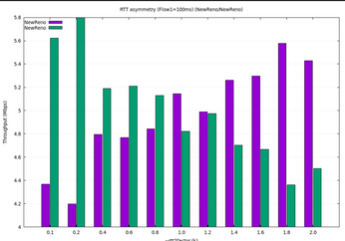
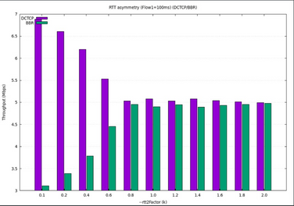
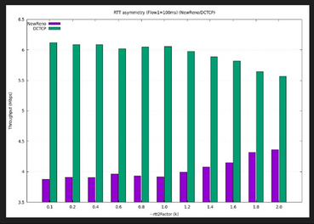
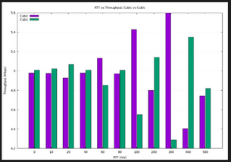
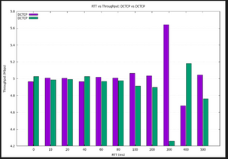
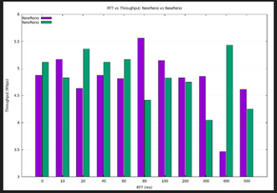
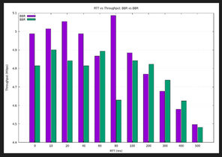
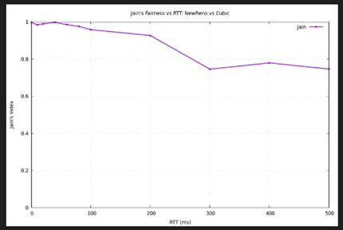
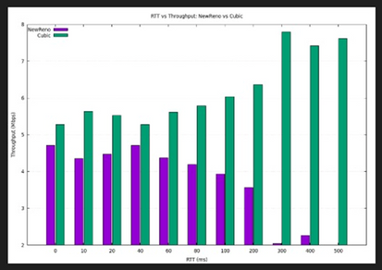
FAINRESS AMONG TCP CONNECTIONS
Research by Adan Watted Alaa Abomokh &Adan Jbara
Advisor Eran Tavor
INTRODUCTION
OBJECTIVE
Fairness in TCP connections is crucial for ensuring that all users and applications get an equitable share of network bandwidth, preventing any single connection from monopolizing resources and causing congestion collapse. This prevents new protocols from harming existing TCP-based traffic, maintains stability, and ensures that the network remains efficient and reliable for everyone.
This project aims to study the following TCP connections: Cubic, New-Reno, BBR &Dctcp, in a dumbbell topology with two flows. , focusing on fairness between them in a shared network.
In our research we focused on two main experiments:
How do RTT asymmetry and mixing different congestion control protocols affect throughput fairness in a shared bottleneck?
How do increase in RTT and mixing different congestion control protocols affect throughput fairness in a shared bottleneck (while both flows have the same RTT)?
METHODOLOGY
dumbbell topology
CONGESTION CONTROL PROTOCOLS - OVERVIEW
We implemented a dumbbell topology in NS-3 to create a controlled bottleneck environment. Each competing flow was assigned specific TCP congestion control algorithms and RTT values according to experimental parameters.
All simulations were automated through custom scripts that configured the protocols, executed runs, and processed output. The scripts calculated average throughput for each flow and computed Jain's Fairness Index to quantitatively evaluate bandwidth sharing fairness. This automated pipeline ensured consistent, reproducible testing across all protocol combinations and RTT conditions.
CUBIC uses packet loss as its signal but responds with a aggressive cubic growth function, enabling it to rapidly reclaim lost bandwidth.
NewReno detects congestion upon packet loss and reacts by halving its congestion window before beginning a slow, linear recovery.
BBR ignores traditional signals like loss and delay, instead using its own model of the network path to proactively pace packets and minimize queueing delay.
DCTCP relies on Explicit Congestion Notification (ECN) from the network and reduces its sending rate proportionally to the severity of the congestion, ensuring smooth and efficient control.
Jain's Fairness Index is a quantitative metric that measures the equality of bandwidth distribution among competing flows. Jain’s Index Formula:
OBSERVATIONS
ASYMMETRY IN RTT
in the instance where both flows have the same protocol,
protocols with loss based congestion detection (new reno, cubic) tend to favor low rtt, such that flows with shorter RTT have higher throughput, causing inequality with distrepution, throughput symmetry occurs only near equal RTTs. Jain’s index remains close to 1, showing moderate fairness overall.
BBR has big diffrences in throughput when one of the flows has low RTT leading to a low jain’s index, but when it reachs 100ms RTT both flows share the bandwidth equally leading to perfect fairness.
Dctcp shows perfect fairness unrelated to it’s RTT.
In mixed networks where flow 1 takes constant RTT of 100ms and flow 2 changes relativly:
Dctcp- dominates and takes most of the throughput in the network, exept with BBR where they manage to share the bandwidth fairly.
Cubic- takes higher throughput when it’s RTT is the
New Reno- gets starved when paired with other protocols espacialy when it’s RTT is higher than the other flow, due to it’s slow congestion window growth
BBR- struggles with low RTT, and performes more efficiently with RTT higher than 100ms.
SAME RTT FOR BOTH FLOWS
mixing different protocols when both have the same RTT results in inequality in the network. Although the relationship between the protocols didn’t change, the differences become more aparent in this senario in comparison to experament 1, and we see that protocols with better adjusting congestion window take over the throughput resulting in clear starvation.
In the instances where both flows have the same protocol, we see that they share the bottleneck link evenly, and Jain’s fairness index stays constant and close to 1.
CONCLUSION
ACHIEVMENTS
When Dctcp is paired with loss based CCA's -NewReno, Cubic- it captures the bandwidth unrelated to RTT but due to its advanced algorithm dealing with congestion.
NewReno gets much less throughput when paired with other CCA's so it nearly losses bandwidth every time.
When BBR has similar RTT to Dctcp and itself it’s protocol friendly. It manages to take appropriate throughput without outperforming the other protocol. But’ with NewReno and Cubic it causes outperformances.
The Max-Min Fairness principle holds when both protocols are the same and both flows have the same RTT. In other cases, it is difficult to determine, since both flows attempt to fully utilize the available bandwidth, but in practice they do not receive an equal share of it.
Modern protocols such as BBR and DCTCP are capable of sharing bandwidth efficiently and fairly, even under complex network conditions.
Gain a solid understanding of TCP congestion control protocols and their behavior in a bottleneck
Gained familiarity with simulating topologies on NS-3
Simulate and test multiple TCP congestion control protocols on the dumbbell topology.
Designing scripts to fit our needs and relay on automating simulation runs
Present data in suitable graphs that help compare protocol performance.
Evaluate and analyze fairness between TCP connections using different congestion control protocols.

